Slide 1

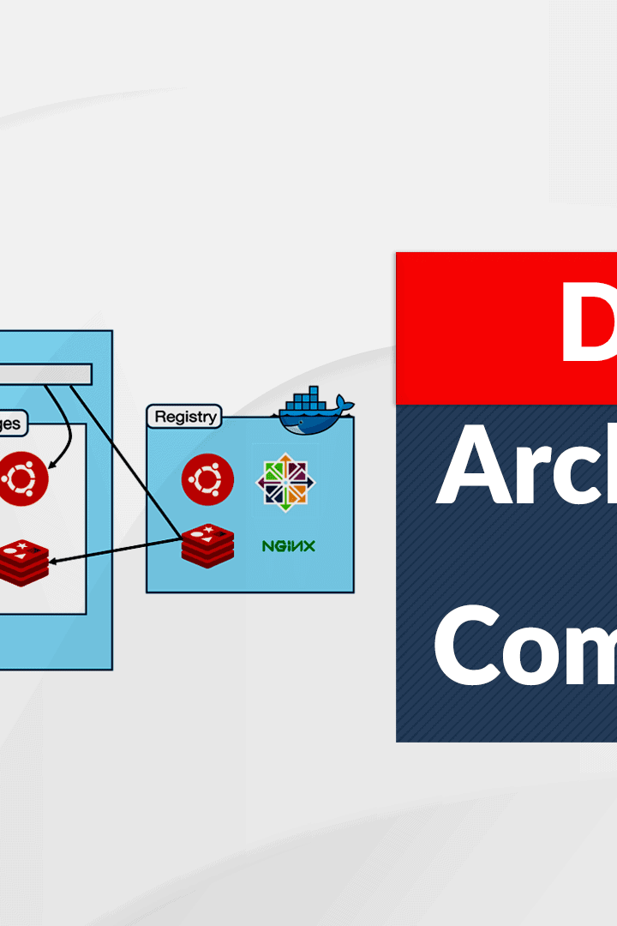
Exploring Docker Architecture
Join us as we dive into the world of Docker architecture and learn about the powerful advantages of using containers for virtualization and application distribution.
CS
by Charanjit Singh

Slide 2

The Advantages of Docker's Containers
1
Portability 🚀
2
Efficiency ⚡️
Docker containers can be run on any platform, simplifying the deployment process.
Docker's lightweight containers create faster build and deployment times and require less overhead.
3
Modularity 🔧
4
Isolation 🔒
Docker's container architecture allows for easy integration with other tools and technologies.
Each container provides a secure and isolated system for running applications.

Slide 3
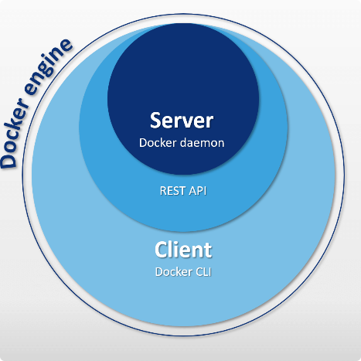

The Docker Engine and Docker Hub
Docker Engine
Docker Hub
The Docker Engine is the underlying technology that enables the creation and management of containers.
Docker Hub is the central repository for storing, managing, and sharing Docker images.

Slide 4
Virtualization and Application Distribution with Docker
Application Distribution Aided by Containers 📦
Docker containers can be used for distributing pre-built applications and microservices with ease.
1
2
3
Virtualization Made Easy 🙌
Scalability Options 📈
Docker virtualization creates consistent environments across multiple systems, reducing conflicts and errors.
Docker's containerized approach allows for increased flexibility, scalability and resource allocation for applications.

Slide 5
Comparing Docker and Traditional Virtual Machines
Docker Containers 📦
Traditional Virtual Machines 💻
Lightweight, portable, share host kernel, fast and efficient.
Heavy, slow to start, resource-intensive, complex to manage.

Slide 6
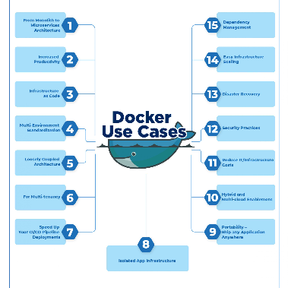
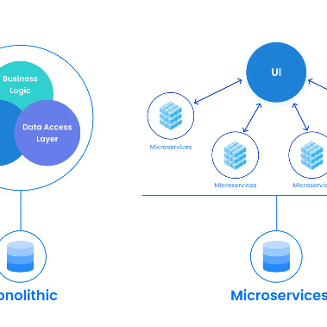
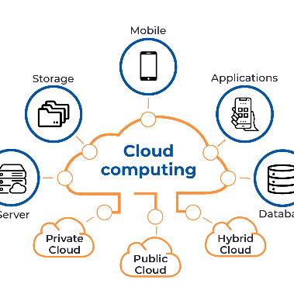
Use Cases for Docker Containers
DevOps 🛠️
Microservices Architecture 🚀
Cloud Computing ☁️
Docker is used extensively in DevOps for automation, testing, and deployment.
Docker allows for easy development and deployment of scalable microservices-based applications.
Docker provides a seamless way to build, package and deploy cloud-native applications.

Slide 7

Conclusion and Key Takeaways
1
Docker Containers are Revolutionary 🚀
2
Choose Containers for Efficiency 🙌
Docker streamlines the application development and deployment process like never before.
Containers can save vast amounts of resources while also increasing flexibility and scalability.
3
The Future is Dockerized ☁️
Docker is leading the charge towards a more modern, lightweight and scalable approach to virtualization and cloud computing.

